Slide 1
AI/ML - MODEL SELECTION

Slide 2
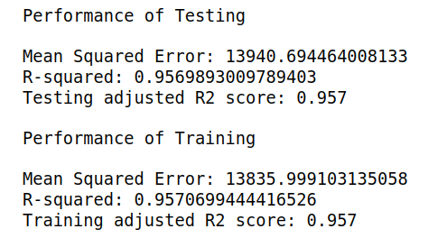
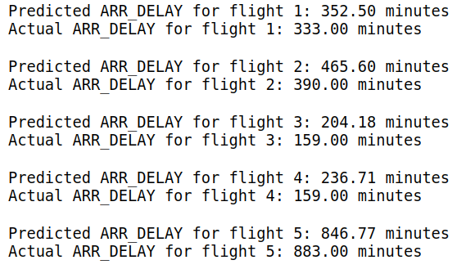
Model Selection
We have gone through various regression models such as Linear Regression, Decision Tree Regression, Random Forest regression, Ridge Regression, and Gradient Boosting, and its performance are given below:
Linear Regression
Model performance :
Performance of model prediction :

Slide 3
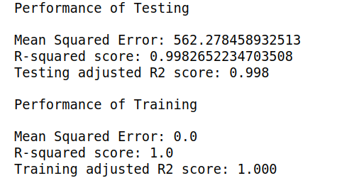
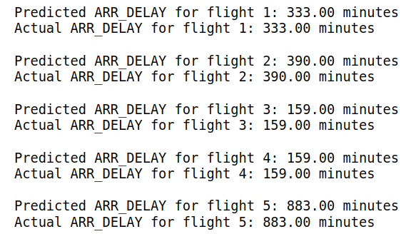
Decision Tree Regression
Model performance :
Performance of model prediction :

Slide 4
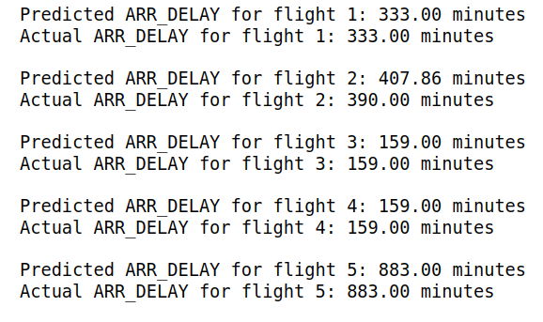
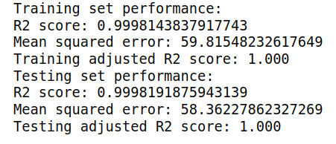
Random Forest Regression
Model performance :
Performance of model prediction :

Slide 5
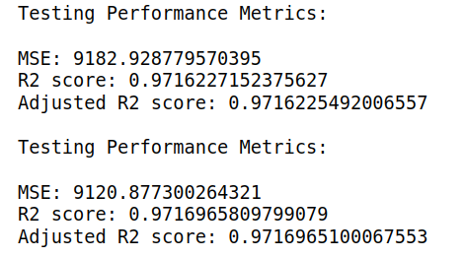
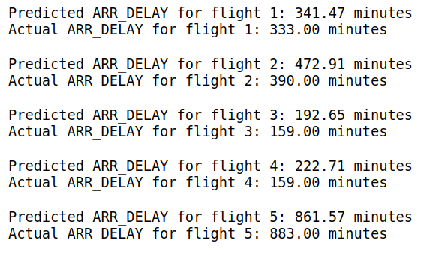
Gradient Boosting Regression
Model performance :
Performance of model prediction :
From all these findings, we have decided to take Random Forest Regression, since it performs better in training as well as testing and provides a better prediction of delay than any other model.

